Slide 1
Html AND css
Forms

Slide 2
forms
forms are everywhere! Examples?
Surfer provides data through forms
Processing data from form with server-sided programming language (php, asp.net,..)

Slide 3
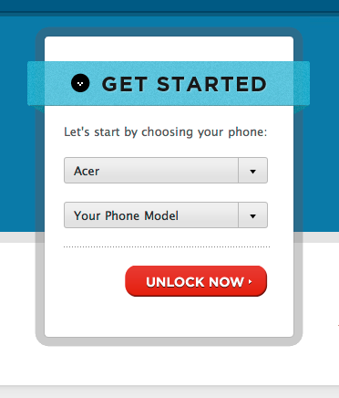
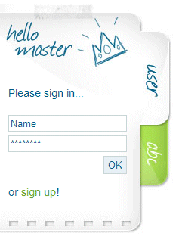
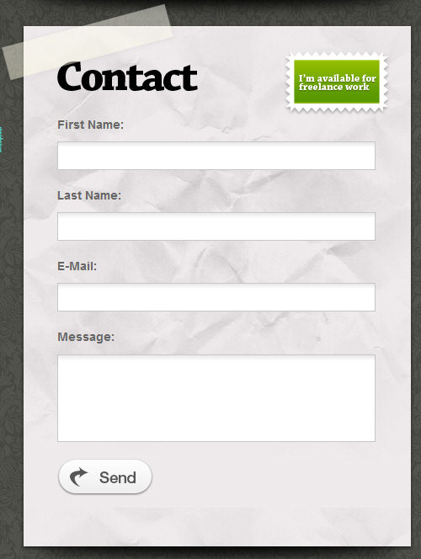

Slide 4
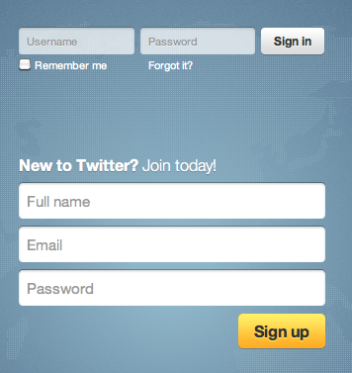
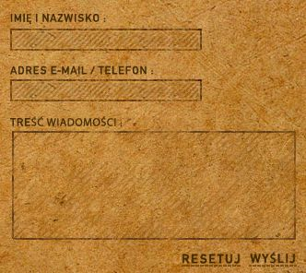
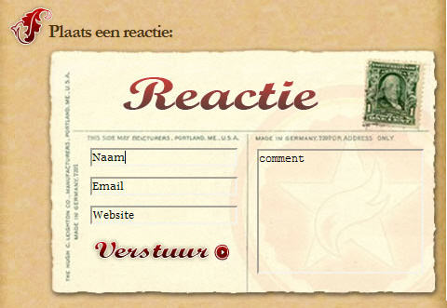

Slide 5

forms

Slide 6
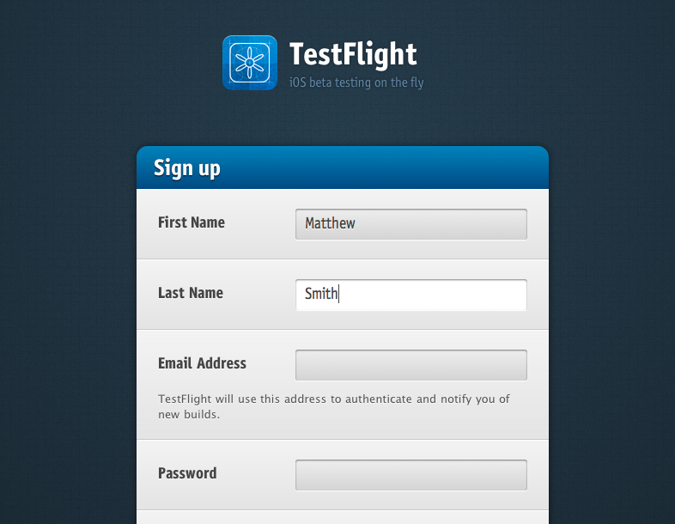

Slide 7
structure form
<form>…</form>
Attributes
method: defines how the data is sent to server
get = appends data to the URL as name/value pairs
visible in URL.
max 8192 characters, only for non-secure data
can be bookmarked
post = appends data in the body of the HTTP request
not visible in URL
no size limitations and safer
cannot be bookmarked

Slide 8
structure form
Attributes
action: specifies where to send form-data after submit
data to script on server, often PHP/asp.net page
data to email: action="mailto:firstname.name@system.be?subject=formresult"
enctype: specifies how to encode the form-data when submitting it to the server
Only for method : post
Used if data is sent to email
Example enctype="text/plain" : form-data is encoded as ASCII text

Slide 9

Form fields: text field
Text field
<input type="text" name="search" id="search" value="test"/>
Create a web page with a text field. Give this text field the name "textfield1" and make sure that at startup the text "Your question?" is shown.

Slide 10

Form fields: text field
Text field with label
<label for="search">Description</label>
<input type="text" id="search" name="search" value="HTML5"/>
id and for attributes must have the same value (here search) to indicate their relation.
Add label to text field of previous exercise

Slide 11

Form fields: checkboxes
<input type="checkbox" name="name" checked="checked" />
Add 2 checkboxes.
Checkbox 1: label="choice 1" and empty
Checkbox 2: label="choice 2" and checked

Slide 12

FORM FIELDS: radiobuttons
<label for="female">female: </label>
<input type="radio" id="female" name="gender" value="female" checked="checked" />
<label for="male">male: </label>
<input type="radio" id="male" name="gender" value="male"/>
Add 3 coherent radiobuttons:
1 with label "option 1" and empty
1 with label "option 2" and empty
1 with label "option 3" and checked

Slide 13
Form fields: Buttons
<input type="submit" value="click here" />
<input type="reset" value="reset" />
<input type="button" />
Add 2 buttons:
1 button "submit" with text "send"
1 button "reset" with text "reset"
When sending, all data must be placed in a mail
What happens if you place the send button outside the form tag?

Slide 14
Other fields
Password field
<input type="password" name="password"/>
Larger text boxes
<textarea name="remarks">
put here a standard starting text
</textarea>
multiple choice list
<select name="hometown">
<option value="ME">Mechelen</option>
<option value="BR">Brussels</option>
<option value="AN">Antwerp</option>
<option value="GE">Gent</option>
</select>

Slide 15
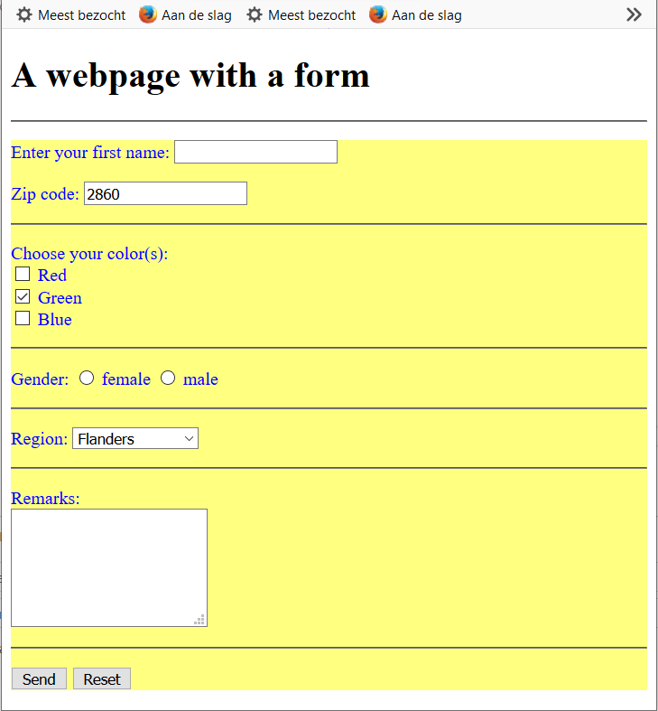
example

Slide 16
Fieldset
To visually group form-elements
<fieldset>
<legend>text</legend>
</fieldset>
Example

Slide 17
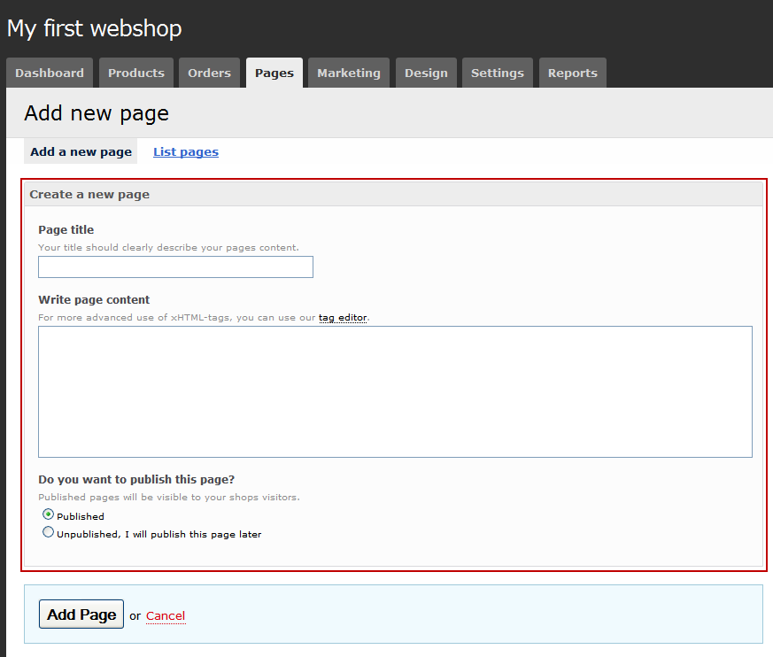
example fieldset

Slide 18
Client-side / server-side
Client-side-scripting
carry out checks on data before sending them => e.g. JavaScript
Server-side-scripting
have form data processed by program on server (PHP, ASP)
E.g.: action="http://www.myserver.be/process.php"

Slide 19
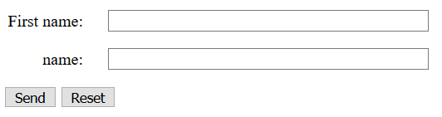
layout
Input fields below each other => use labels for corresponding text.
example

Slide 20
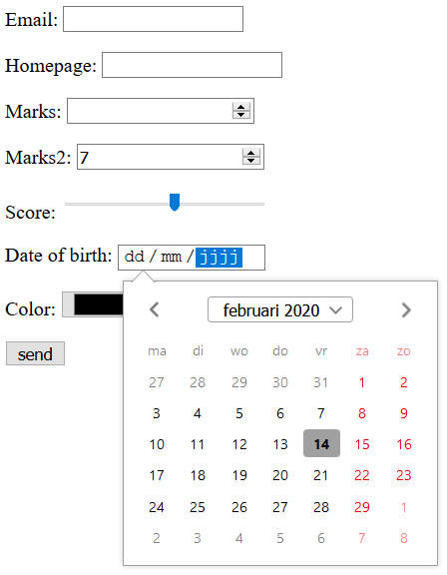
HTML5: new input types
tel
email
url
number
range
date
datetime-local
other datepickers
search
color
example
Support information

Slide 21
HTML5: new form elements
<datalist> !!not in Safari
list of predefined options for <input>
provides "autocomplete" on <input> element
<input>: use list attribute to bind <input> and <datalist>
<output>
Result of a calculation
example

Slide 22
HTML5: new form Attributes
autocomplete
"on" / "off"
novalidate
No validation of form data before submitting form

Slide 23
HTML5: new input Attributes
autocomplete
autofocus
form attribute (niet IE)
Override
formaction: overrides form action attribuut
formenctype: overrides form enctype attribuut
formmethod: overrides form method attribuut
formnovalidate: overrides form novalidate attribuut
formtarget: overrides form target attribuut

Slide 24

HTML5: new input Attributes
List (not: Safari)
min, max en step
multiple
novalidate
pattern
placeholder
Required

